Slide 1
Module 3

Slide 2
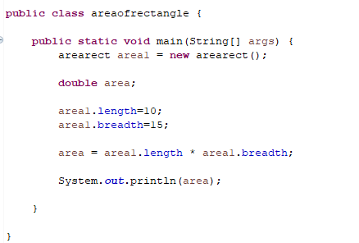
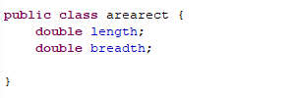
Example 1: area of rectangle
Create a class

Slide 3
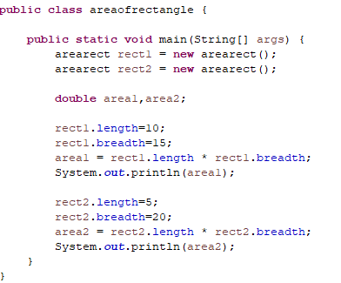
Creating multiple objects

Slide 4
Method declaration
Type specifies the type of data returned by the method.
If the method does not return a value, its return type must be void.
The name of the method is specified by name.
The parameter list is a sequence of type and identifier pairs separated by commas.
Parameters are essentially variables that receive the value of the arguments passed to the method when it is called.
If the method has no parameters, then the parameter list will be empty.

Slide 5
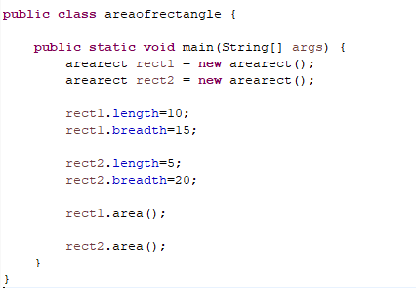
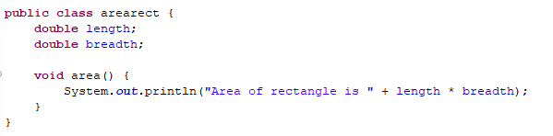
Adding method to area program

Slide 6
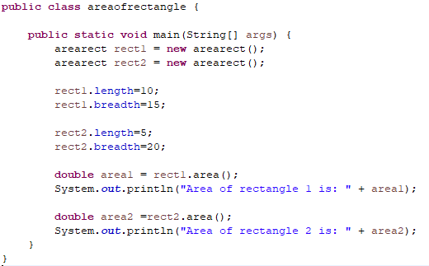
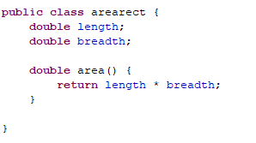
Method with return value

Slide 7
Method with return value
There are two important things to understand about returning values:
The type of data returned by a method must be compatible with the return type specified by the method.
The variable receiving the value returned by a method must also be compatible with the return type specified for the method.

